Slide 1
Bank Loan Case Study
DSECRIPTION
This case study aims to give you an idea of applying EDA in a real business scenario. In this case study, apart from applying the techniques that you have learnt in the EDA module, you will also develop a basic understanding of risk analytics in banking and financial services and understand how data is used to minimize the risk of losing money while lending to customers.
Business Understanding
The loan providing companies find it hard to give loans to the people due to their insufficient or non-existent credit history. Because of that, some consumers use it as their advantage by becoming a defaulter. Suppose you work for a consumer finance company which specialise in lending various types of loans to urban customers. You have to use EDA to analyse the patterns present in the data. This will ensure that the applicants capable of repaying the loan are not rejected.

Slide 2
Approach
first downloaded the two csv file and imported into excel for the analysis this is the large set of data and it takes more time for cleaning ,after wards I started the analysis (EDA) of given data
Tech-Stack Used
excel ,power point ,notepad
Insight
BY DOING THIS ANALYSIS I GOT KNOW ABOUT THE EDA AND IT IS VERY IMPORTANT FOR EVERY DATA ANLYSIST AND
ALSO LEARNED THE ADVANCE EXCEL TECHNNIQES AS WELL FORMULA OF THE EXCEL I GOT MORE CONFIDENCE IN
CLEANING THE DATA AND VISULAIZING THE DATA AND MADE THE CORELATION AND DIFFERENT TYPE OF THE ANALYSIS

Slide 3
Present the overall approach of the analysis. Mention the problem statement and the analysis approach briefly
There are three data sets namely application_data.csv contains all the information of the client at the time of application. The data is about whether a client has payment difficulties.
previous_application.csv contains information about the client’s previous loan data. It contains the data whether the previous application had been Approved, Cancelled, Refused or Unused offer.
columns_descrption.csv is data dictionary which describes the meaning of the variables.
There are so many unwanted rows and column are present in the data(in two data sets) first I removed the unwanted data from the given data after that I started the EDA
the given datasets are

Slide 4
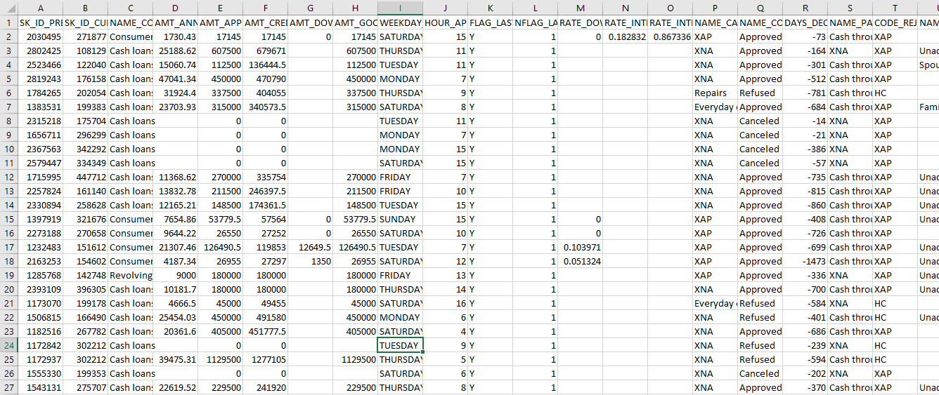
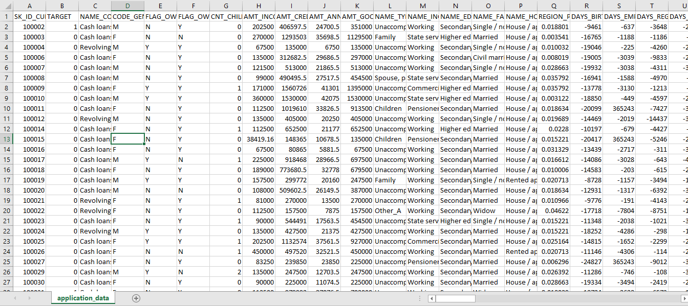

Slide 5
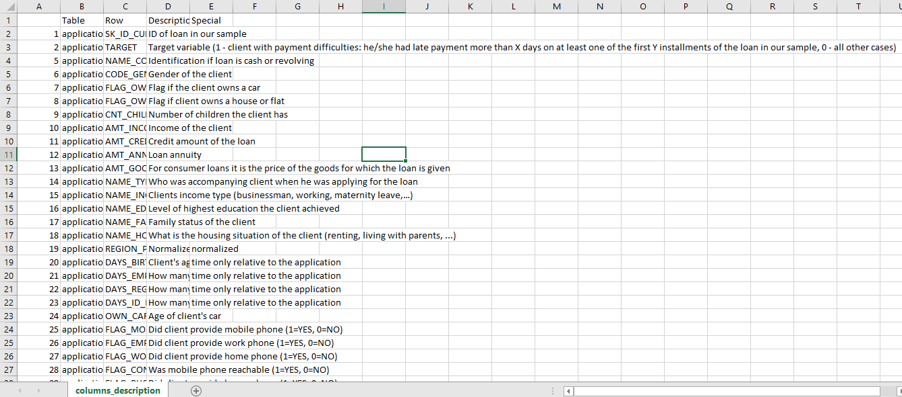
For clean data using some of the statistics method for analysis like iqr,quartiles and removing the
Unnecessary data which are not needed

Slide 6
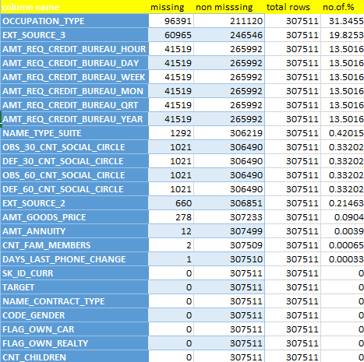
Identify the missing data and use appropriate method to deal with it.
Application_data.csv
Before cleaning the data there are 307521 rows and 122 column are present
AND deleted some of the unwanted column means more then 40% of blank data where present in the data
only less then 40 % and needed column are used
and used the count and countblank and counta formula for this
cleaning and I not replaced any value in this data
In the below 40 percent missing value column there are some
unwanted data which are not needed ONLY 40 column are needed
to analysis

Slide 7
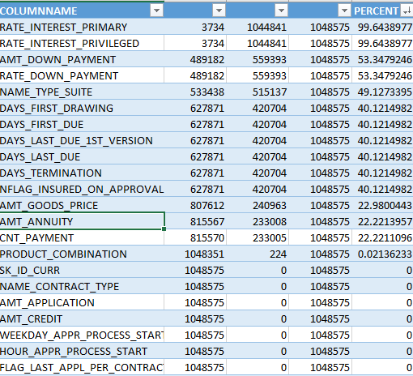
previous_application.csv
Before cleaning data there are 37 column and 1048576 are data are present Important notice that original data is 17670216 but in excel their no option for that much bigdata also it is like analyzing the sample data
In this data there are so many column having 40% of null values so I removed that column also deleted unwanted data which is not useful for the analysis for this analysis I
Used count ,COUNTA and COUNTBLANK function
And also I not replaced any value and only 14 column are need

Slide 8
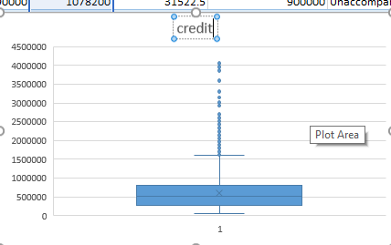
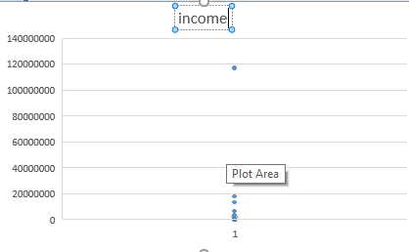
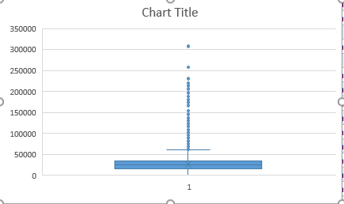
Identify if there are outliers in the dataset
Finding the outliers using the IQR method and finding the upper bound and lower bound and DOING EDA
 | AMT_INCOME_TOTAL | AMT_CREDIT | AMT_ANNUITY | AMT_GOODS_PRICE
COUNT | 307515 | 307515 | 307503 | 307237
AVG | 168797.7236 | 599020.2079 | 27110.22133 | 538391.1997
Q3 | 202500 | 808650 | 34596 | 679500
Q1 | 112500 | 270000 | 16524 | 238500
MEDIAN | 147150 | 513531 | 24903 | 450000
S.D | 237121.8732 | 402491.0906 | 14511.4141 | 369446.4769
IQR | 90000 | 538650 | 18072 | 441000
UPPER BOUND | 337500 | 1616625 | 61704 | 1341000
LOWER BOUND | -22500 | -537975 | -10584 | -423000

Slide 9
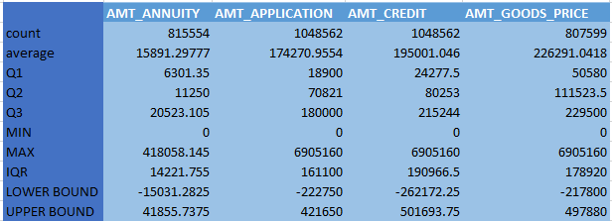
Previous data
Using the q1 and q3 got the IQR and find the upper bound and lower bound as well and t is very important to remove the outliers of this given data and it also contain the null values and there are many data that excluding the lower and upper bound

Slide 10
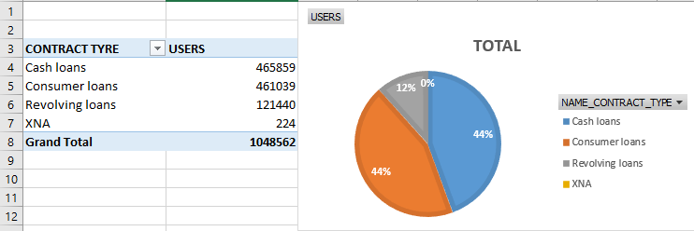
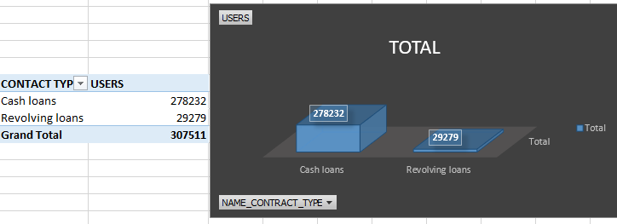
Identify if there is data imbalance in the data. Find the ratio of data imbalance.
CONTRACT TYPE
THERE ARE 4 DIIFFRENT CONTR
ACT TYPES AND TOTAL THIS
TYPE OF LOAN ARE THIER
TYPES OF LOANS
THEIR 2 TYPE OF LOANS
CASH LOANS AND REVOLVING
LOANS ARE SANCTIONED

Slide 11
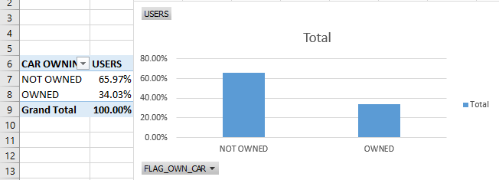
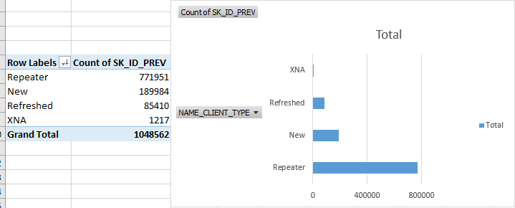
CAR OWNED
IN 100 PERCENT CUSTOMERS THERE ARE
66% ARE NOT OWNED CAR AND 34 % ARE
OWNED CAR
CLIENT TYPE
THERE ARE 4 TYPES OF CLIENT TYPE IN
THE BANK, REPETER ARE MORE COMPAR
ED TO OTHER

Slide 12
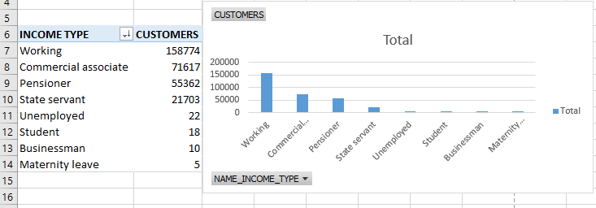
Results of univariate, segmented univariate, bivariate analysis
UNIVARIATE NUMERICAL ANALYSIS
IN THIS ANALYSIS FIRST PICTURE SHO
WS INCOME TYPES AND LOAN SANCTI
ONED AND 2ND PICTURE CLIENT TYPE
WHO GOT THE LOAN
THIS ANALYSIS IS MADE USING EXCEL
AND USING PIVOT TABLE AND THIS
IS THE UNIVARIATE ANALYSIS

Slide 13
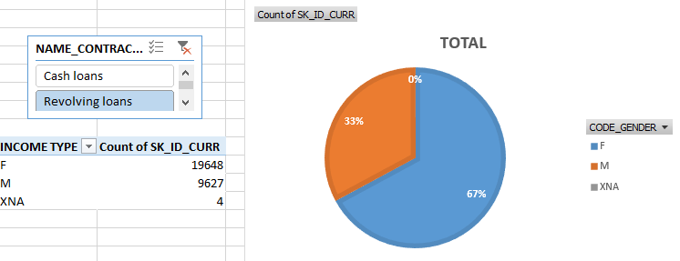
BIVARIATE ANALYSIS
IN THIS DATA ,IT GIVING THE INFORMATION OF LOAN GOT FOR MALE AND FEMALE AND ALSO THE CONTRACT THAT IS CASH AND RESOLVING LOAN THIS IS THE BIVARIATE ANALYSIS

Slide 14
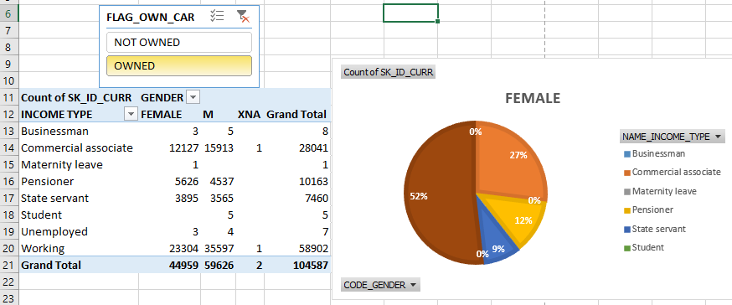
ANOTHER VISULAIZATION OF THE BIVARIATE ANLYSIS CUSTOMER INCOME TYPE AND WHO OWNED THE CAR AND NOT AND WHO GOT THE LOAN AND THIS IS MADE BU USING PIVOT TABLE

Slide 15
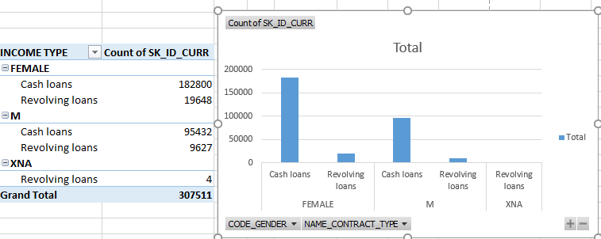
SEGMENTED UNIVARIATE ANALYSIS
IN THE SEGMENTED TYPEOF ANALYSIS GETTING THE INFORMATION OF MULTIPE DATA IN SINGLE VISULAIZATION GENDER AS WELL TYPE OF LOAN WHO GOT THE LOAN

Slide 16
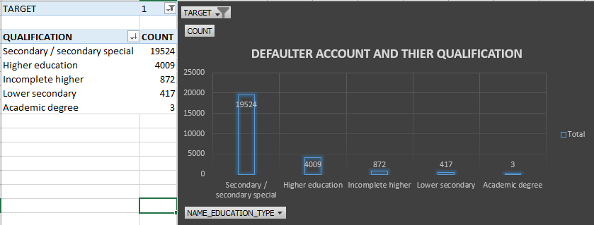
Correlation for the Client with payment difficulties and all other case
I MADE THIS USING THE PIVOT TABLE AND ALSO MADE FILTER FOR THE TARGET COULMN
AND GIVING THE RELATION OF DEFAULTER BASED ON THE THEIR QUALIFICATION
MORE ARE SECONDARY OR SECONDARY SPECIAL

Slide 17
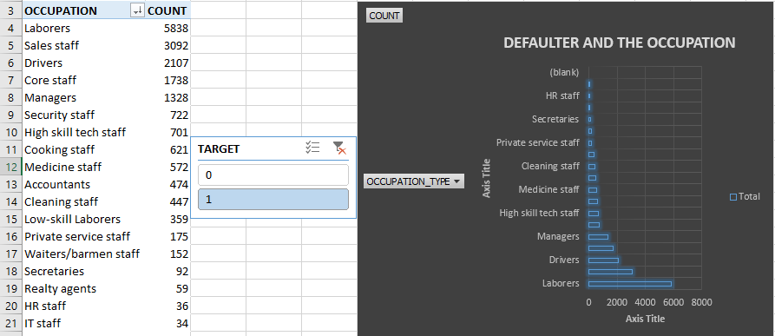
OCCUPATION OF THE DEFAULTER THERE ARE MANY OCCUPATION IN THAT LABORERES ARE MORE
WE CAN SAY THAT DEFAULTER ARE MORE IN THE LABORER SETION AND I NOT INCLUDED BLANK CELL FOR THIS ANALYSIS AND ALSO ADDED SLICER FOR TARGET U CAN CHECK ANY

Slide 18
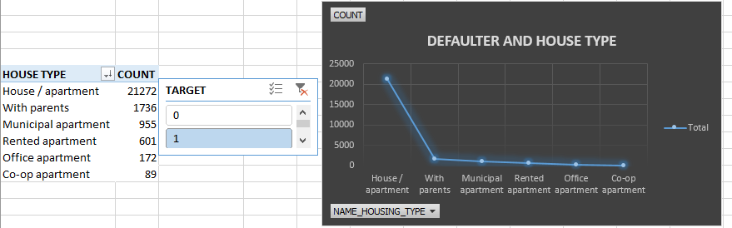
HOUSE TYPE OF DEFAULTER MORE ARE HOUSE OR APARTMENT AND THERE IS DRASTICALLY DOWN FOR OTHER HOUSE TYPE AND THI THE RELATIONS AND THIS IS MADE USING POVOT CHART AND PIVOT TABLE

Slide 19
WE CAN SAY THAT MORE DEFAULTER ARE MEN
SECONDARY AND SPECIAL ARE MORE DEFAULTER
IT STAFF ARE LESS DEFAULTER
THERE IS DRASTICAL DECRESE IN HOUSE TYPE AFTER HOUSE AND APARTMENT
PEOPLE WITH 0 AND 2 CHILDREN TEND TH LOAN
ACDEMAIC DEGREE HOLDER ARE LESS DEFAULTER
PEOPLE LIVING RATE MORE THEN3 HAD MORE DEFAULTES
CO AP OPAERTMENTS PEOPLE ARE LESS DEFAULTER
WOMEN HAD LESS DEFAULT RATE
APPLICANT WITH INCOME MORE THEN600000 ARE LESS DEFAULT

